Slide 1
PERSONAL CARBON TRADING AND EQUILIBRIUM PERMIT PRICE
FOR ROAD TRANSPORTATION
Yeong-beom Kwon
(Transportation Engineering laboratory, Seoul National University)
Introduction
Research Objectives
1) To find the utility maximizing equilibrium price of a carbon permit, type 1 price*.
2) To investigate the change in individuals’ choices of mode of road transportation and
develop the formulation and the searching algorithm for the type 2 price of carbon**.
3) To use an example to examine whether the prices are significant enough and whether the
changes between the prices are large enough to consider the type 2 equilibrium state.
Methodology
Model Assumption
1) Utility follows Cobb-Douglas utility function.
2) Total trip number for each Origin and Destination per person is fixed.
3) The carbon permits can be traded without any transaction costs in the market.
4) Over-emitters are who emit more than the initial allowances. (= demand for permits)
5) Under-emitters are who emit less than the initial allowances.
(= supply of permits)
7) All of the excess emission have to be traded by the specified period.
8) The demand elasticity for transport mode is neglected.

Slide 2
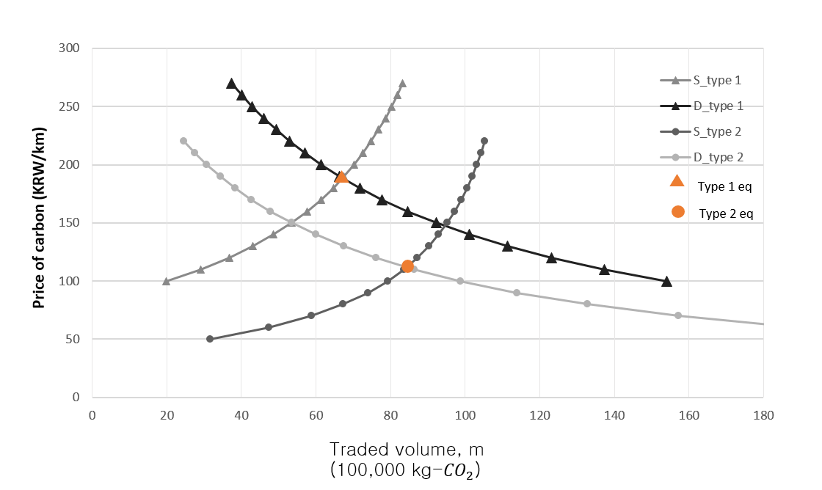
Results
Sensitivity analysis of changes in distance travelled
Distance (km) | Type 1 price (KRW) | Type 2 price (KRW) | Changes in price | Changes in welfare
 |  |  |  | Total welfare | Over-emitters’ welfare | Under-emitters’ welfare
10 | 1569.1 | 1150.5 | -26.7% | 1.7% | 1.0% | 2.2%
20 | 648.6 | 428.4 | -33.9% | 2.2% | 1.4% | 2.8%
30 | 341.8 | 207.3 | -39.4% | 2.6% | 1.8% | 3.4%
40 | 188.4 | 111.9 | -40.6% | 2.7% | 2.1% | 3.7%
50 | 96.37 | 65.3 | -32.3% | 1.9% | 1.6% | 4.6%
Carbon permit market for the example problem
Conclusion
Conclusion
The type 1 price was found by solving the optimization problem, and, accordingly, the changes in demand for automobile use were observed.
The type 2 price is achieved by the search algorithm by checking to determine whether the changes in the previous price and the current price were less than or equal to 0.1 KRW.
Significant changes were detected by comparing the type 1 and the type 2 states.
    Therefore, the analysis for PCT should include additional changes after its implementation to analyze all of its effects on society.
    The type 2 price may provide a more accurate estimation of the price than the type 1 price.
    As people travel greater distances, they pay less KRW per km, which may not affect drivers’ behaviors to the same extent as people driving less distances.

